Slide 1
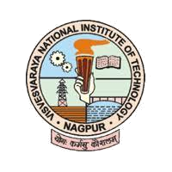
B.Tech Project Final Evaluation A-IoT CUBE Smart farm soil monitoring using IoT
by
Animesh Jha BT17MEC012
Dhananshu Gupta BT17MEC031
Harshal Wadekar BT17MEC040
D. Vivek Vardhan BT17MEC034
Under the supervision of
Dr. SHITAL CHIDDARWAR
Visvesvaraya National Institute of Technology
Nagpur

Slide 2
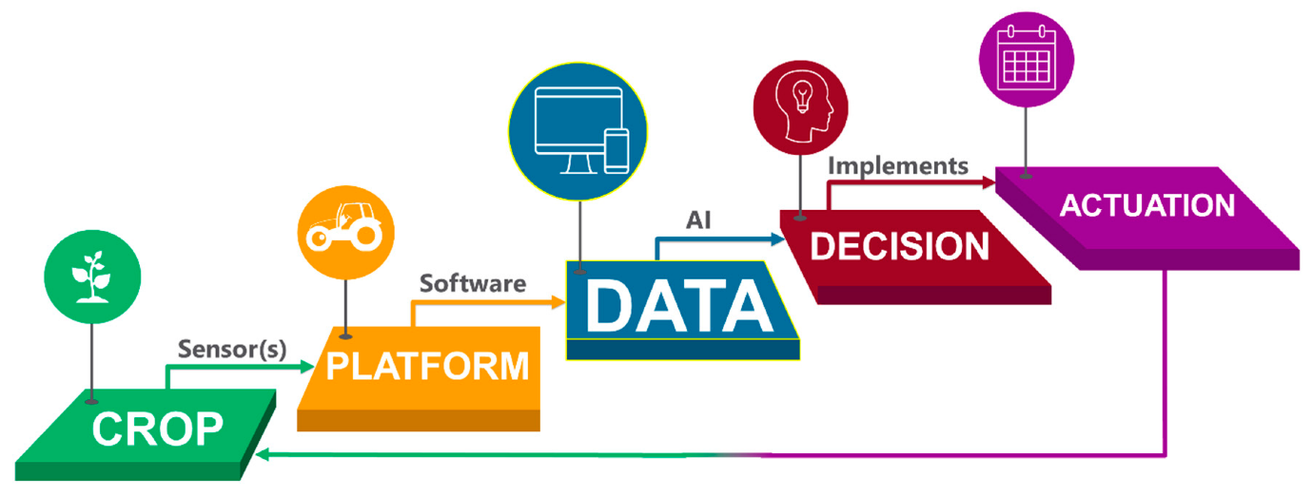
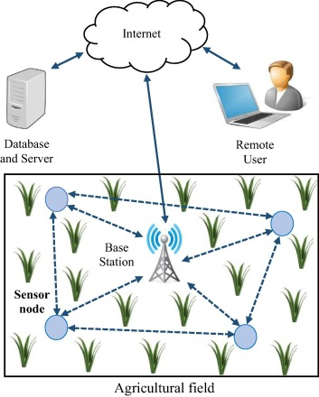
Objective:
Real time data collection of various soil characteristics using sensors with the help of Arduino and processing this data to bring out useful insights.
Using Artificial Intelligence to portray and predict the trend of their farm characteristics in a simple and understanding way for the farmer.
Alerting the farmer about the current condition of the soil through SMS alert / Mobile application with a user friendly GUI.
Help farmers to take decision on what to grow next and what and when to add and how much to add.
Overall this project aims to interpret valuable information from farms to help improve the crop yield and optimize the use of resources.

Slide 3
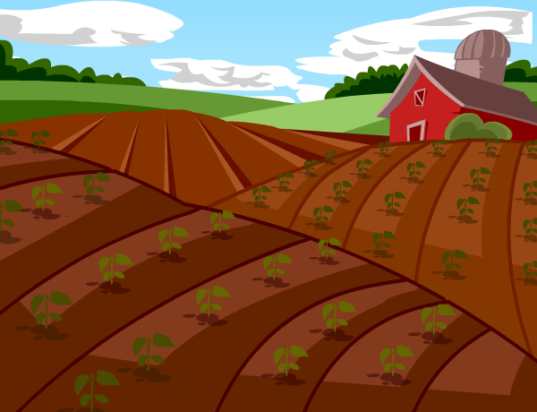
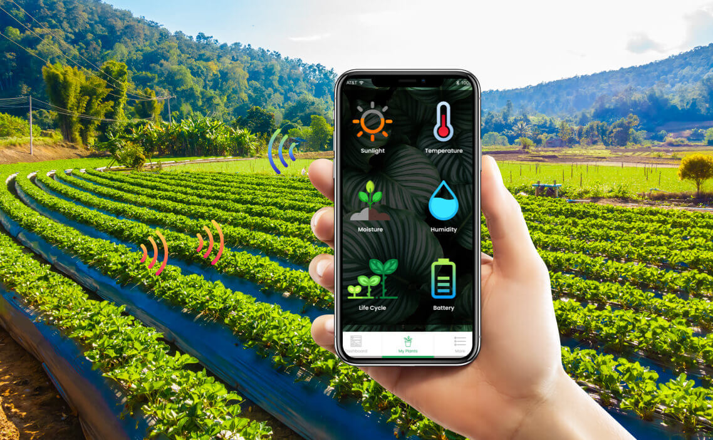
Visual:
AIoT Cube

Slide 4
Methodology:
Problem Analysis
Literature Review
Finalizing the parameters and sensors
Circuit establishment & programming
CAD Model Designing & Sensor Calibrations
Data acquisition on cloud, communication between Cubes
Analysis using ML Algorithm, setting up Notification Alert System
Conclusion
Mobile Application Development

Slide 5
Literature Review
IoT Based Smart Agriculture: Towards making the fields talk (Mhd. Ayaz, Mhd. Ammad-Uddin, Zubair Sharif, Ali Mansour, El-Hadi Aggoune) research paper dated August 1, 2019 :-
A review research paper providing various insights of the State-of-the-art IoT based agriculture practices that are being carried out in the world, highlighting upon the scope of the inculcating IoT based technology in farming, it’s application, potential soil parameters that are vital, identifying current and future trends in IoT agriculture and highlight potential research challenges.
Also covers the concept of camera based crop monitoring, which involves image processing for detection of anomalies, monitoring the plant health, use of UAVs in agriculture.

Slide 6
In his research paper ‘State –of –the-Art Internet of Things in protected agriculture’, Xianjie Shi divided IoT in three different parts : object end, (smart items ,smart devices which all interact with physical world ), cloud end ( sensing data and from the object end and extracting) and network end (communication of the object and cloud end).
The paper talks about structure of IoT in protected agriculture, which has many layers : perception layer( consists of various sensors),Network Layer( converged network form by sensors),Middleware Layer( filter and process received data ),Common platform layer( storage, decision making), Application layer.
Applications of IoT in Protected agriculture , some of them are: Plant management, Animal Farming, Agri-food Supply Chain Traceability.

Slide 7
Component List:
Sr. No. | Components
1 | Arduino UNO and Nodemcu
2 | RS485 Soil Moisture Sensor
3 | DHT22 Temperature and Humidity Sensor
4 | ESP8266 WiFi Module
5 | 2*1500mAh 7.4V Li-Ion Battery
6 | Breadboard
7 | 12V, 10W Solar Panel
8 | GSM Module (for SMS Alerts)
9 | NRF24L01 Radio Transceiver Module
10 | Jumper Wires
11 | Resistances

Slide 8
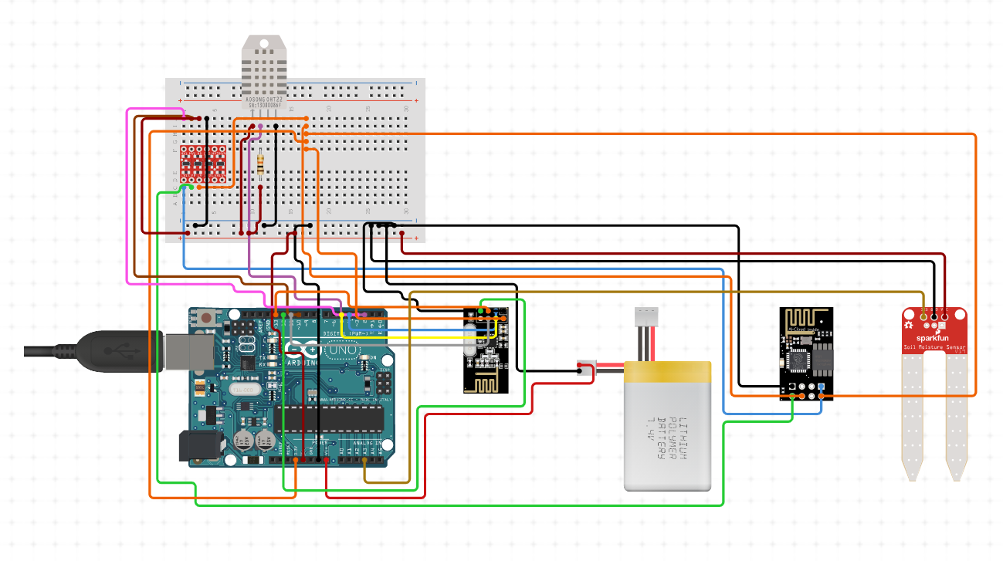
Circuit Diagram:

Slide 9
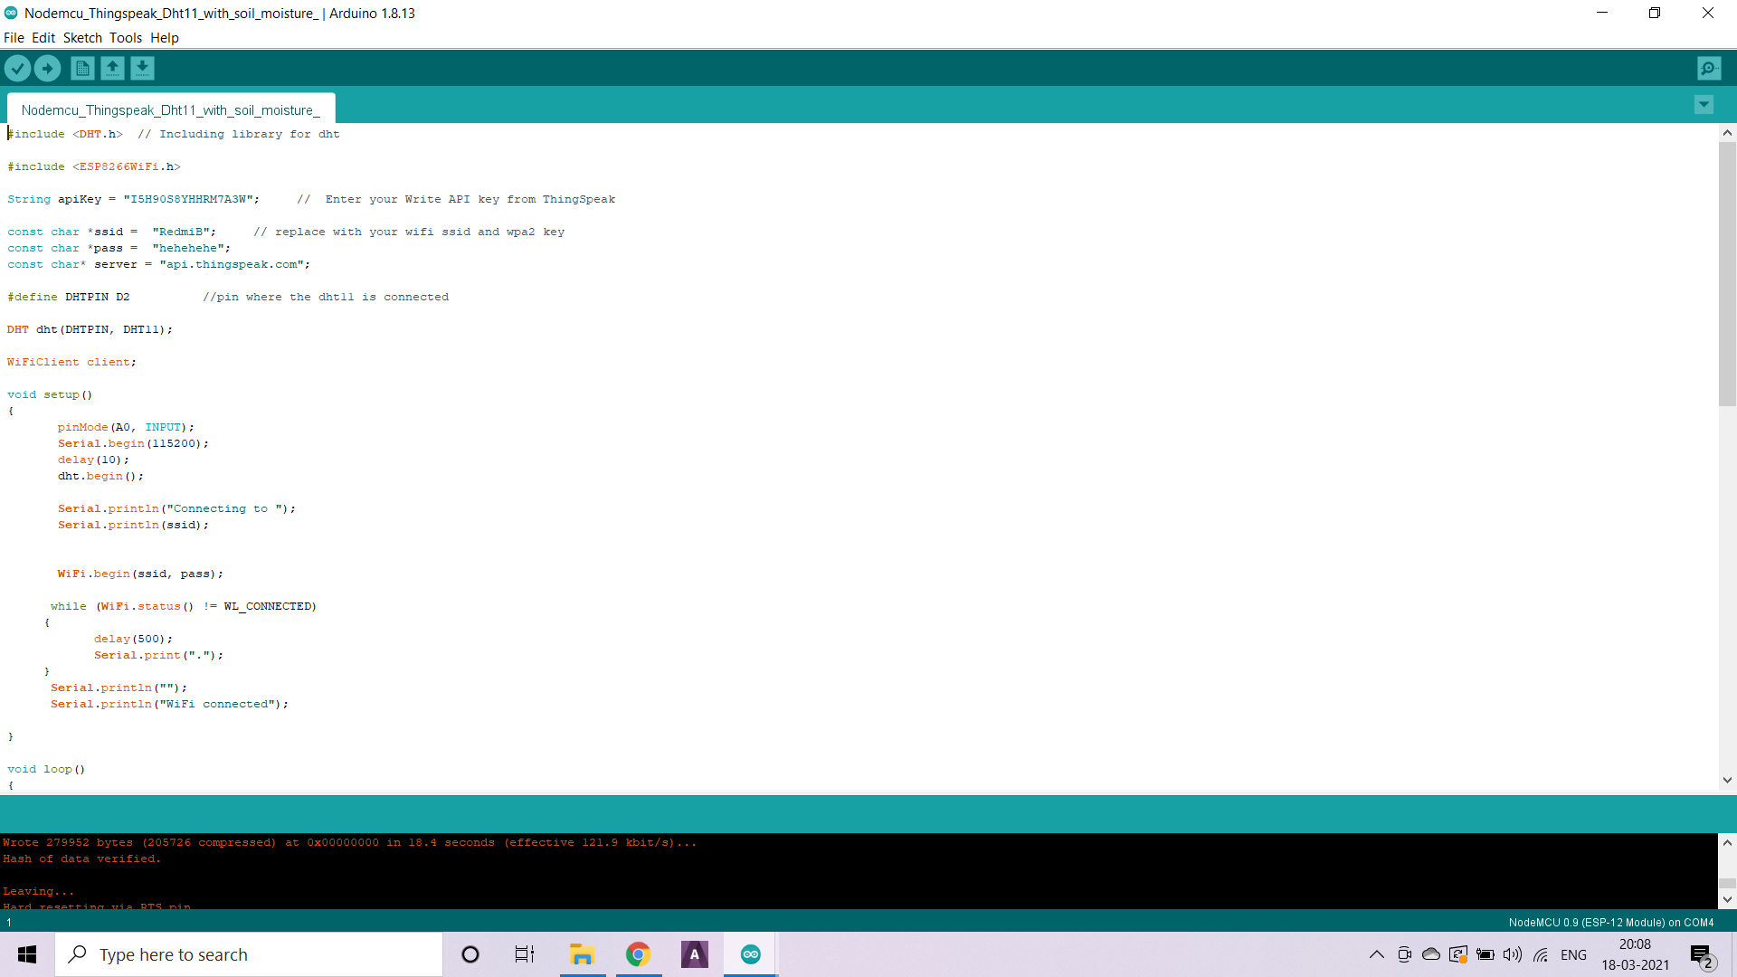
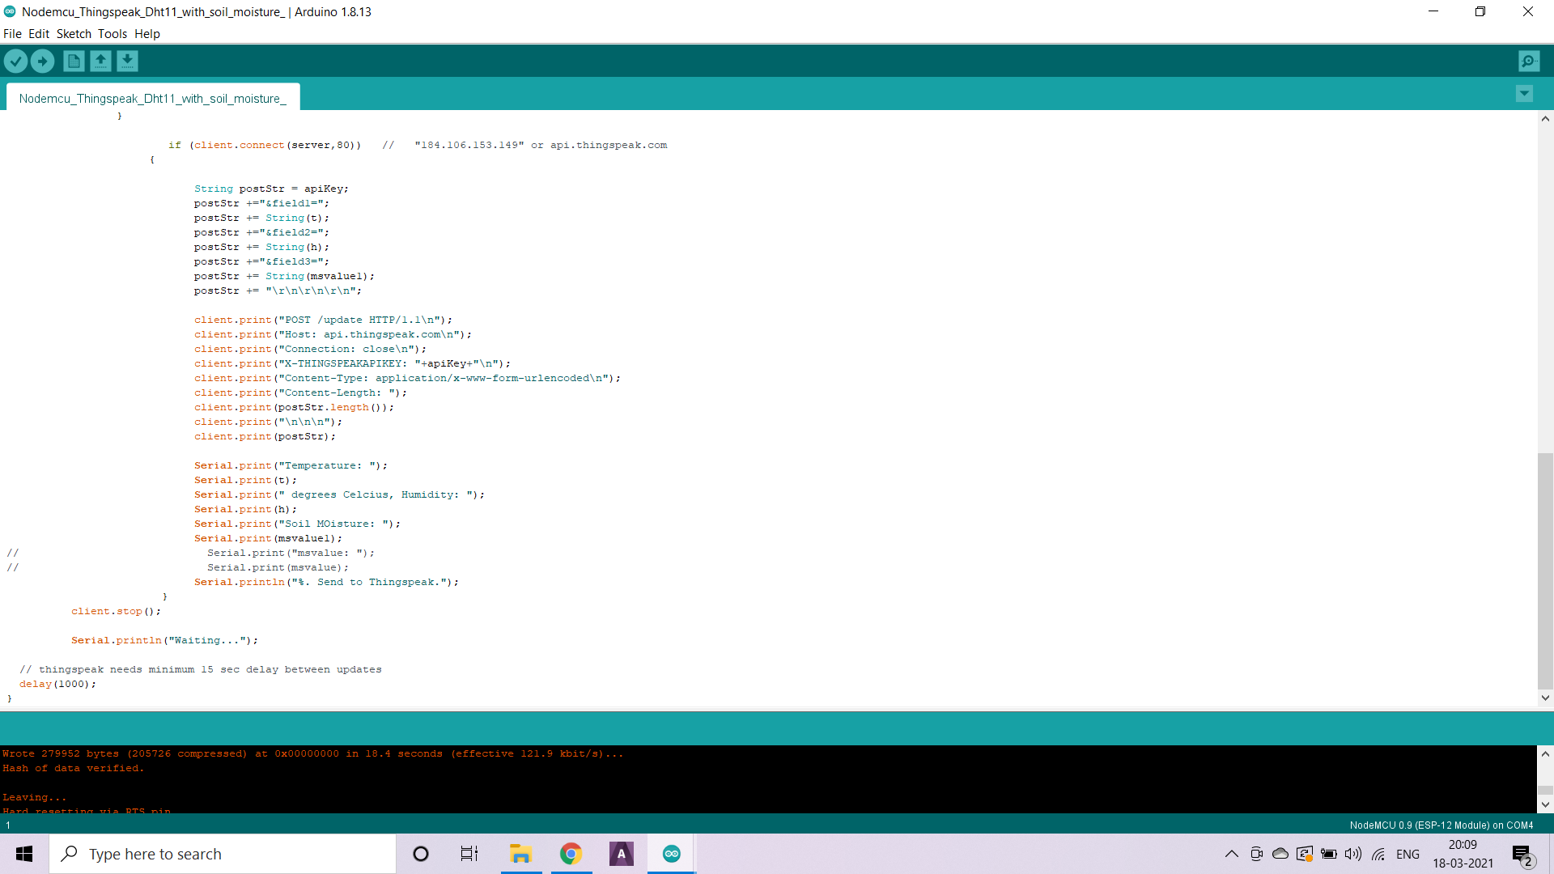
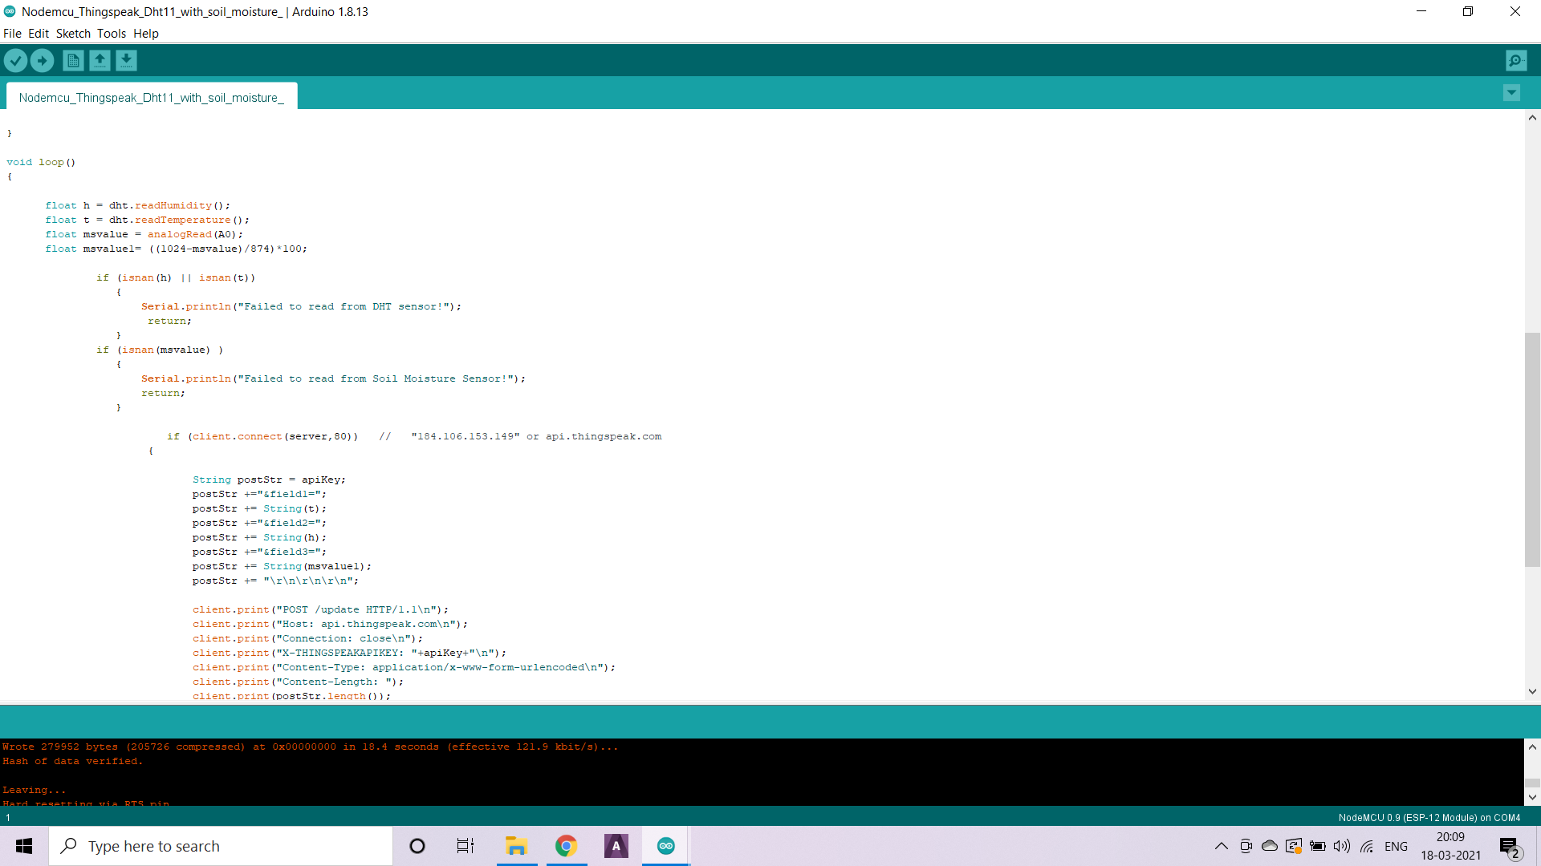
Master Code

Slide 10
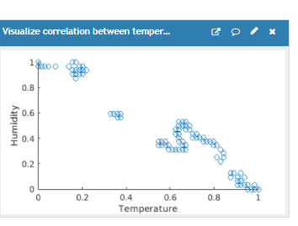
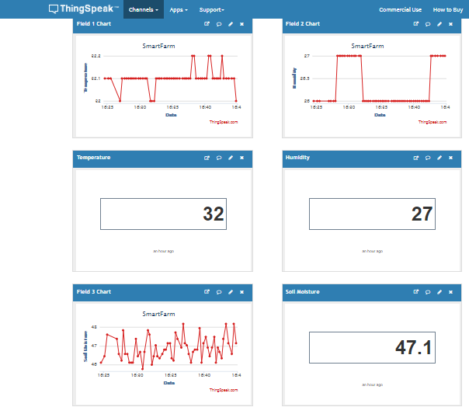
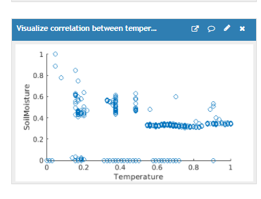
Output from Thing Speak

Slide 11
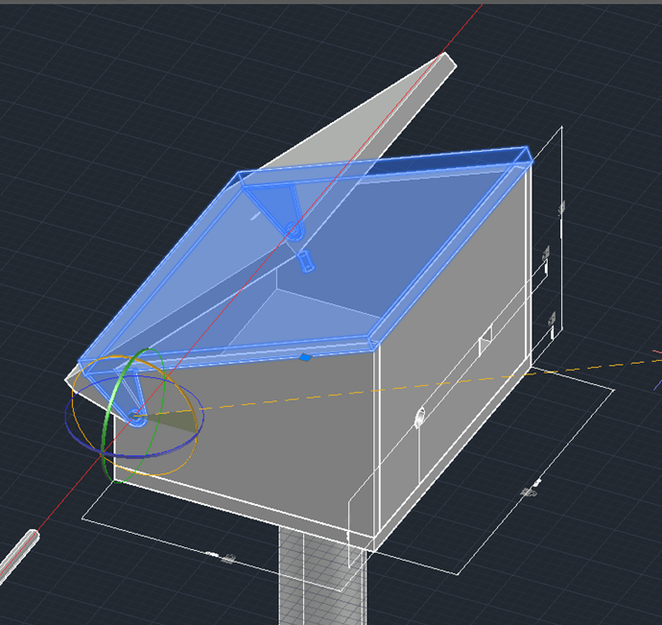
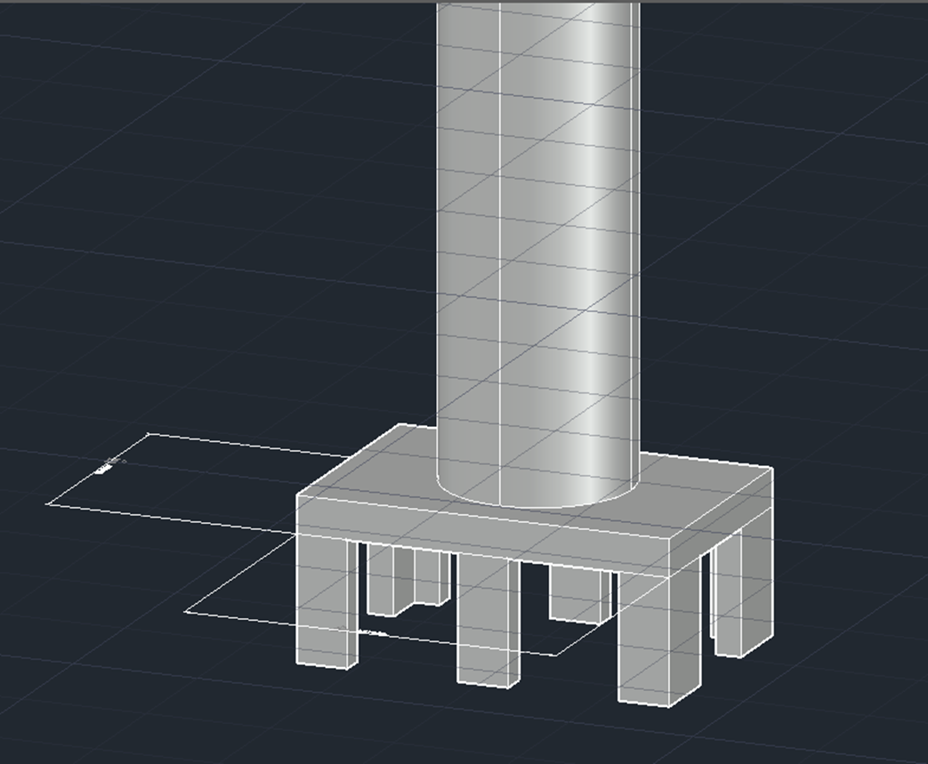
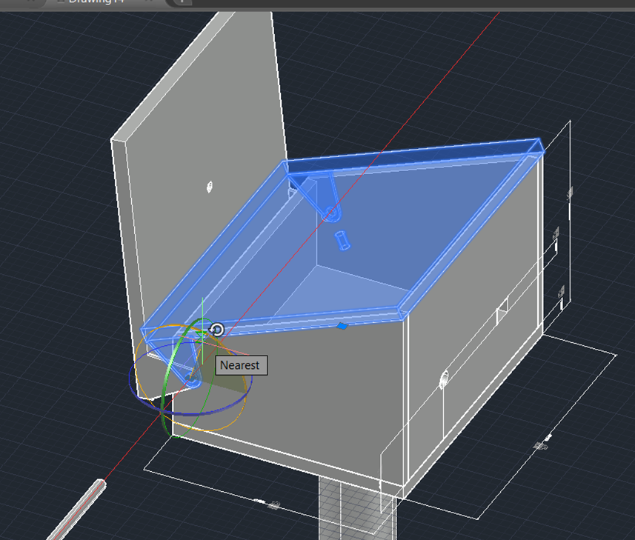
CAD Model of the Cube:

Slide 12
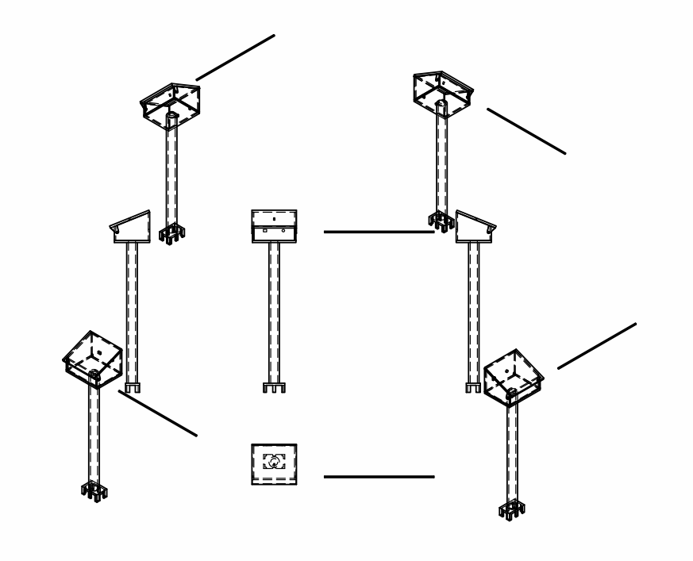
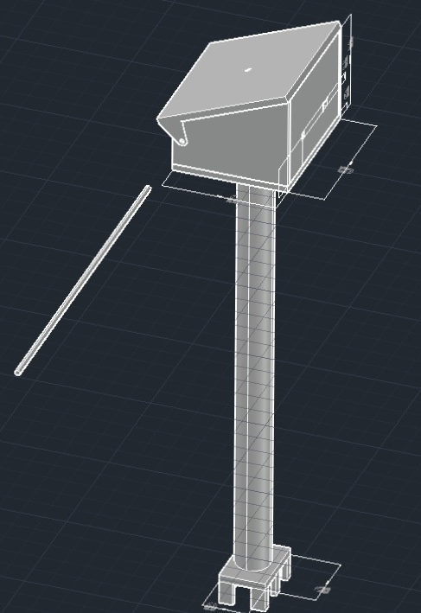

Slide 13
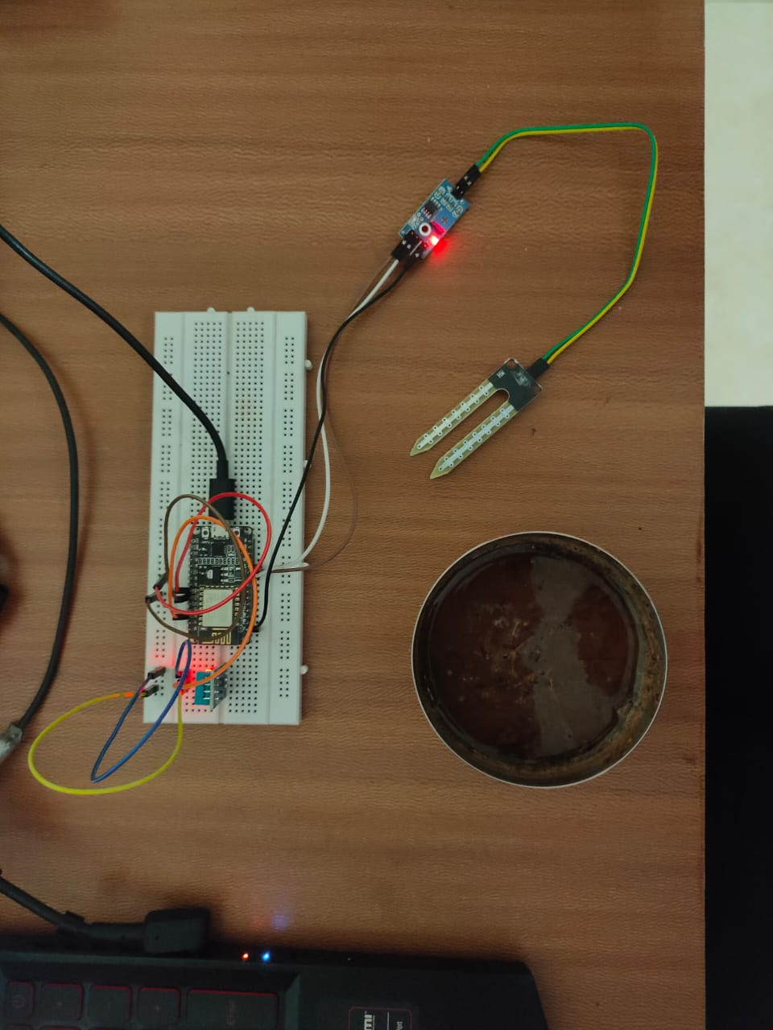
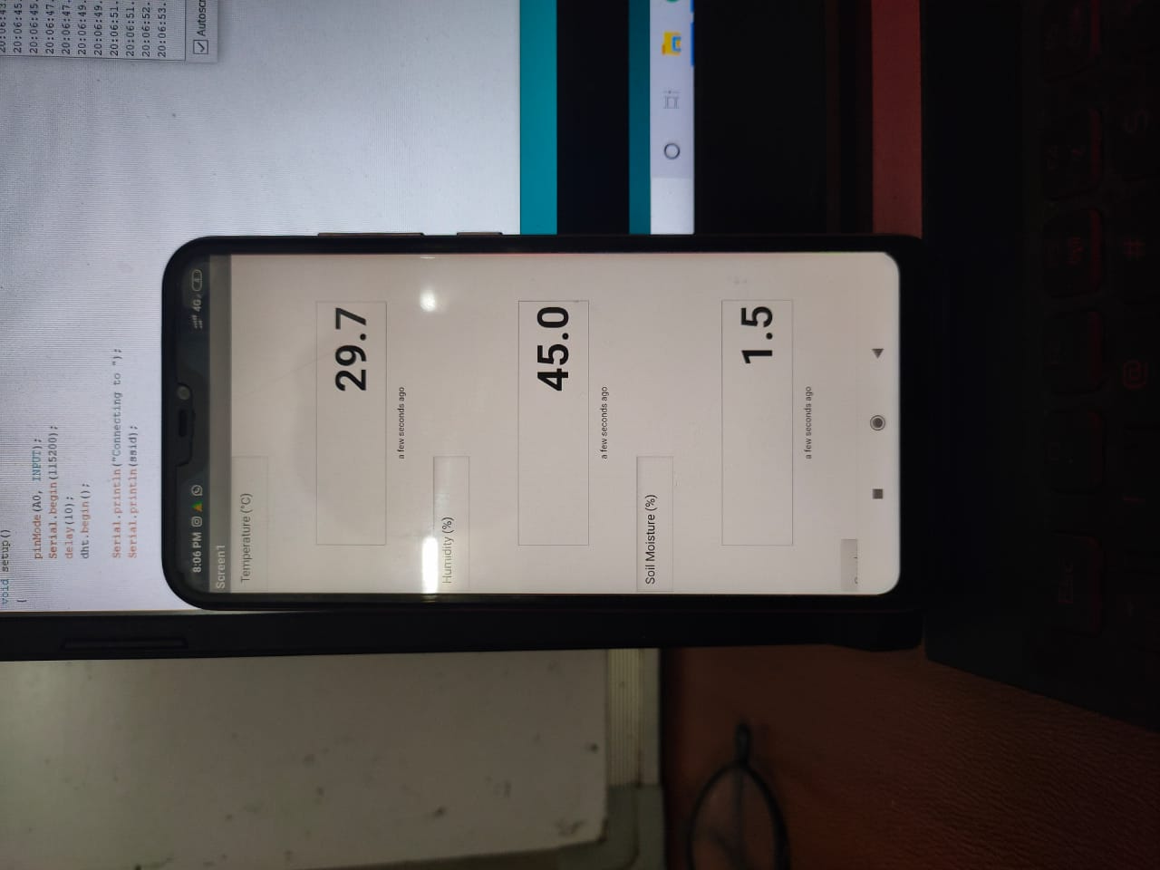
Model Run at 8:06 pm on 18-03-2021
Soil Moisture Sensor in dry condition

Slide 14
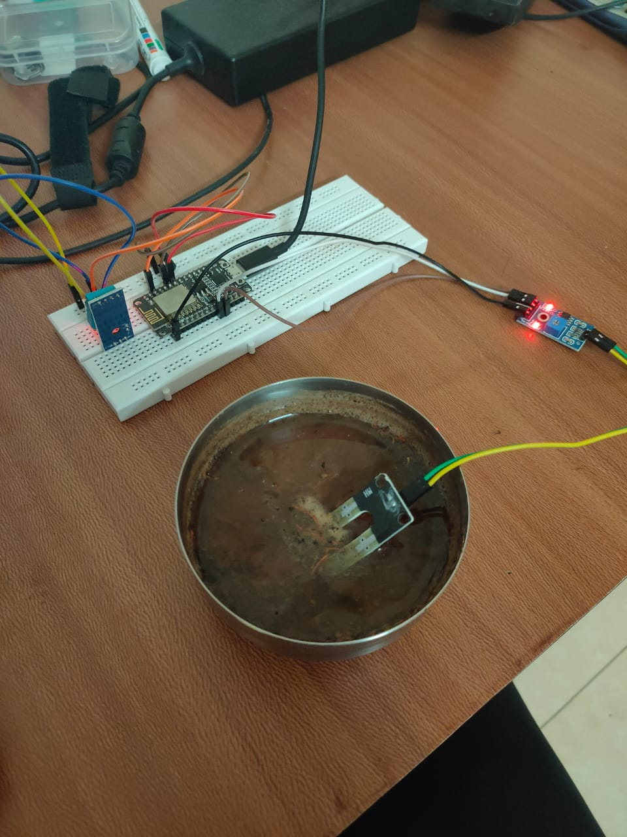
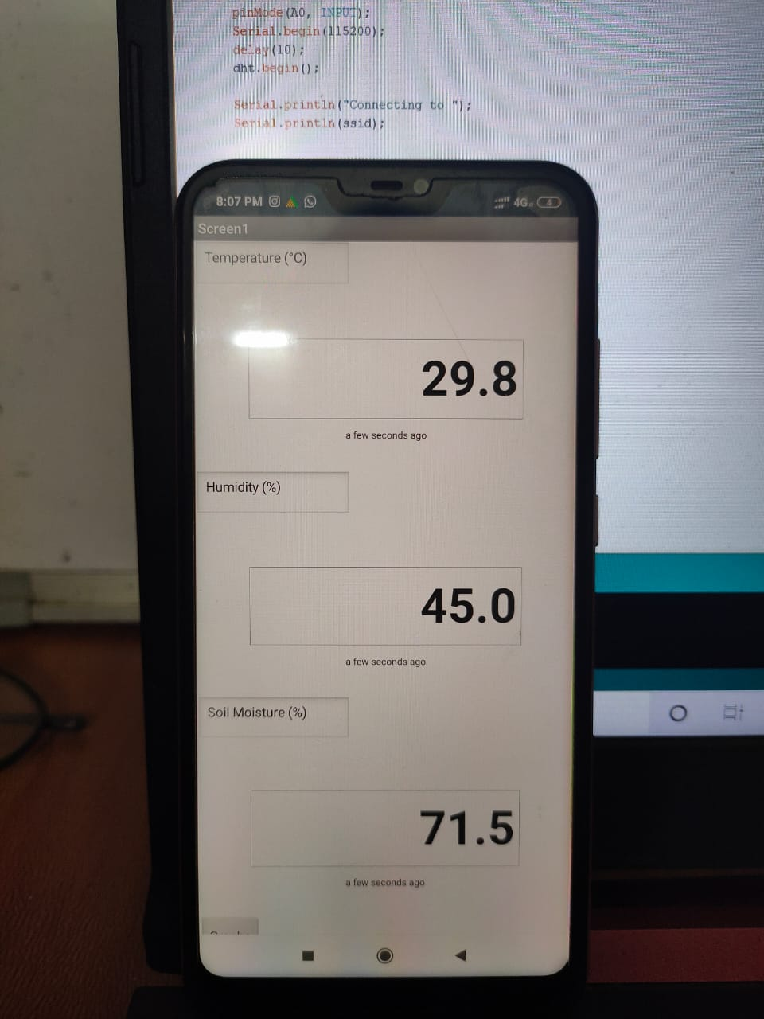
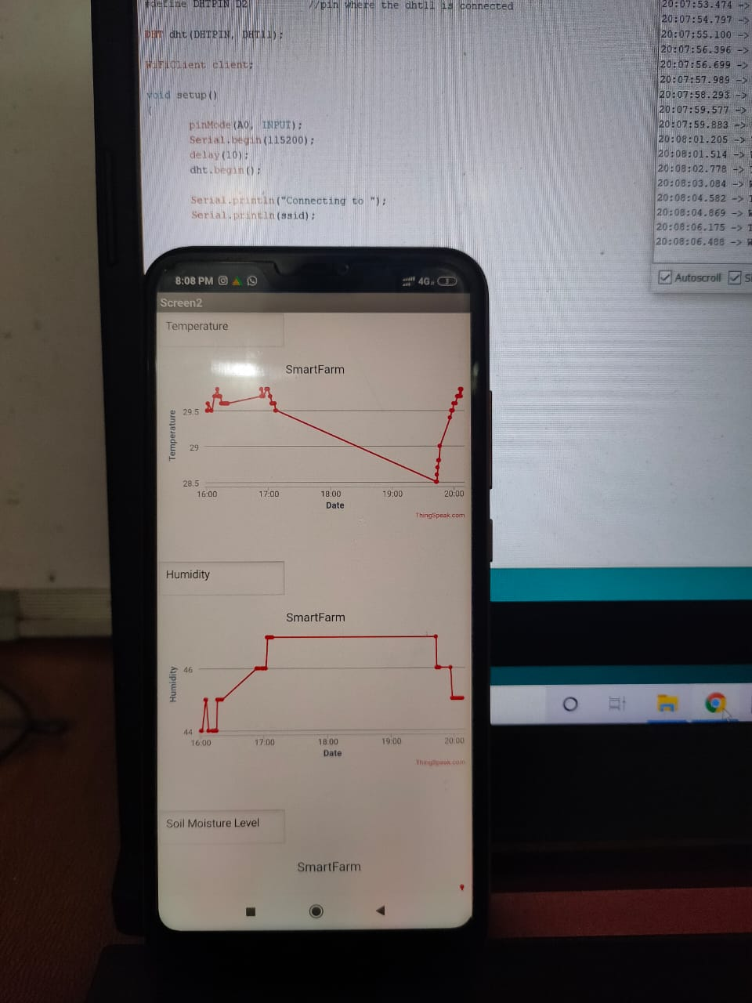
After inserting the sensor into an excessively high moisture soil mixture
Real-time Digital Readings from the App
Graphical Readings (Value vs Time)

Slide 15
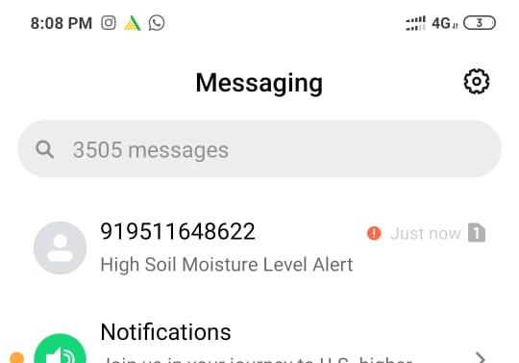
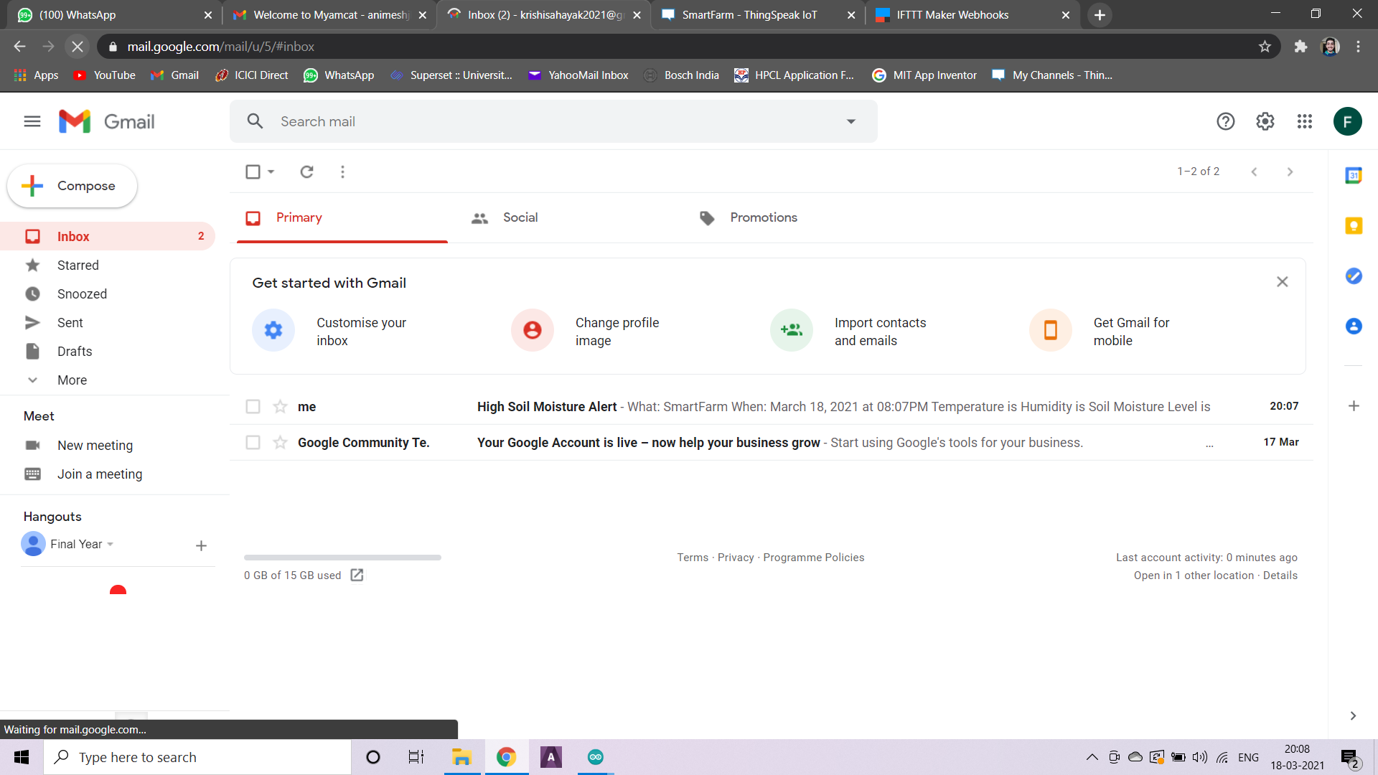
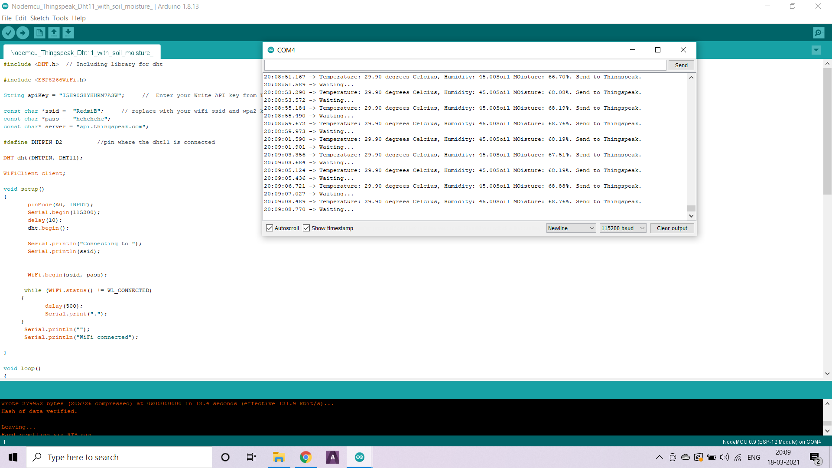
Notification Alerts

Slide 16
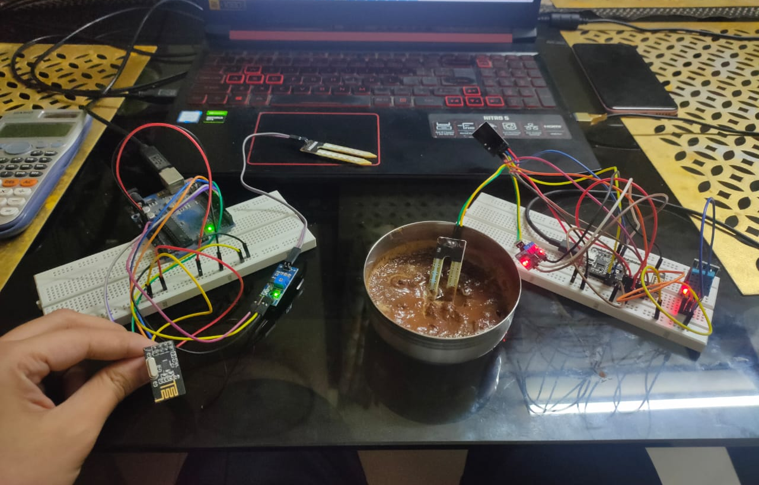
Radio Communication Between Master & Slave Circuits using NRF24L01 Transceiver Module
Master Circuit (Receiver)
Slave Circuit (Transmitter)

Slide 17
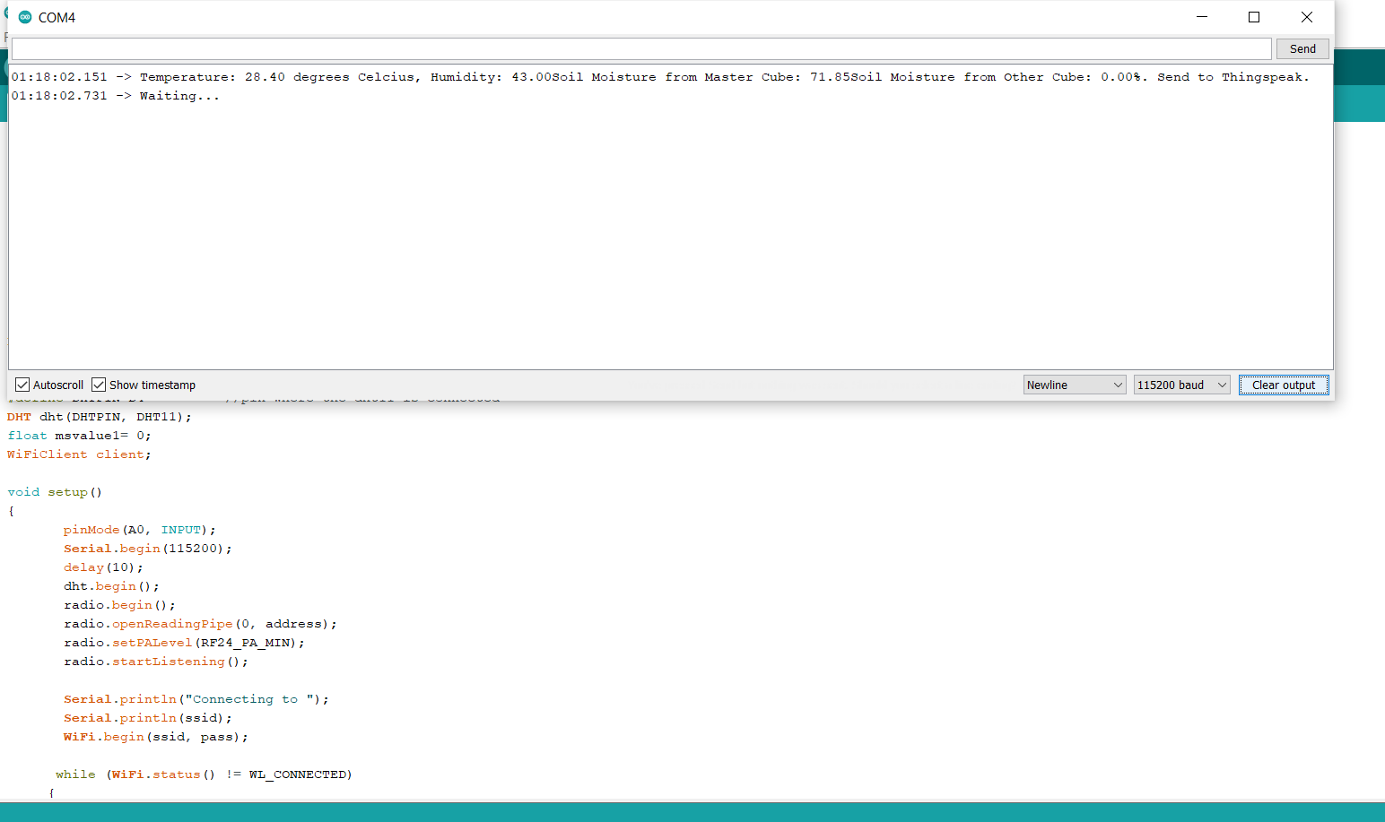
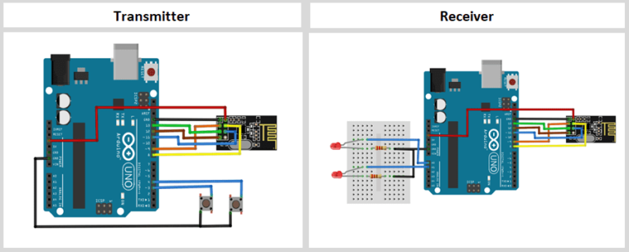

Slide 18
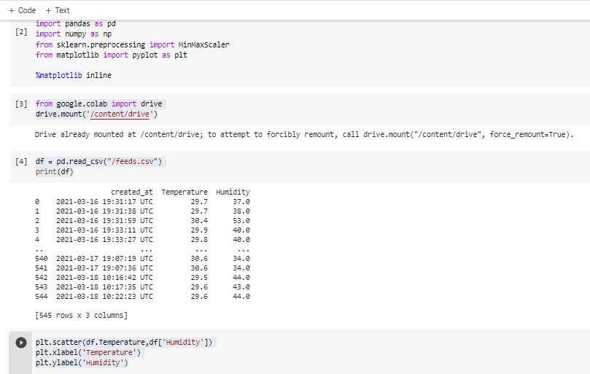
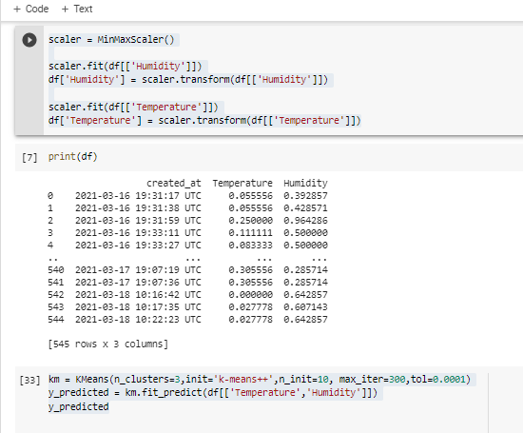
K mean clustering algorithm (Code written in Google collab )

Slide 19
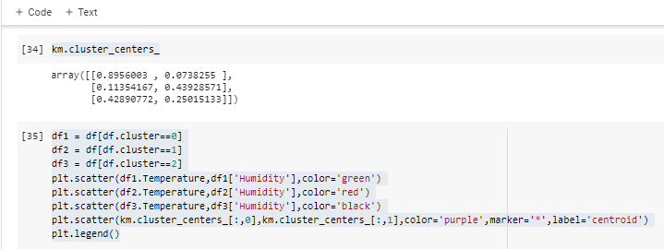
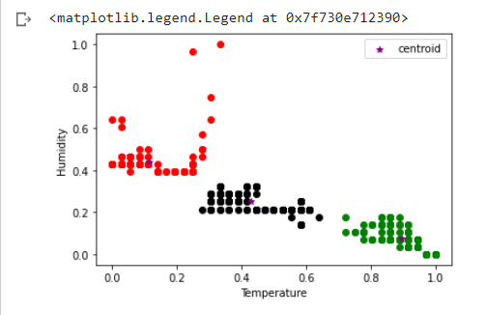
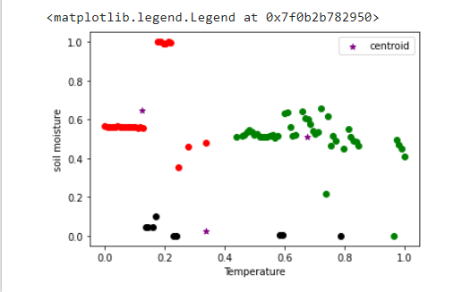

Slide 20
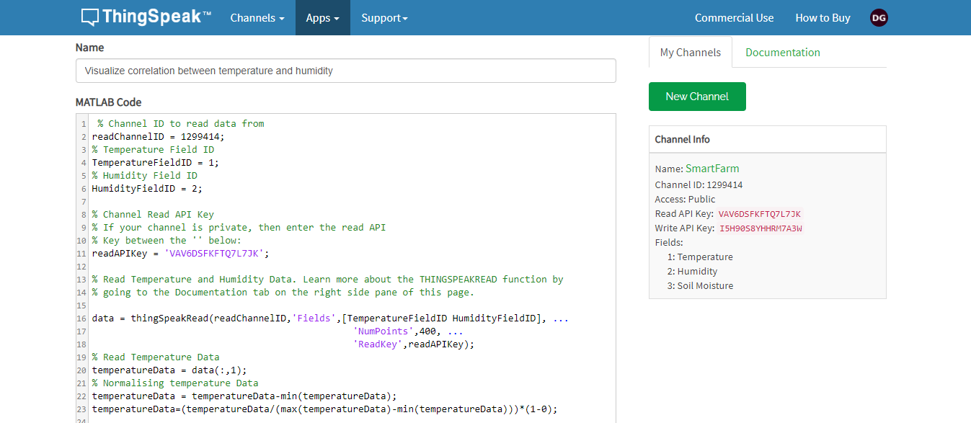
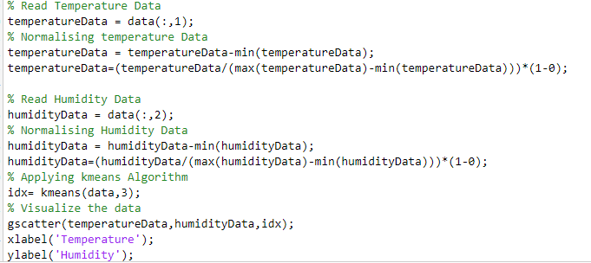
Implementing ML Algorithm directly on ThingSpeak (MATLAB)

Slide 21
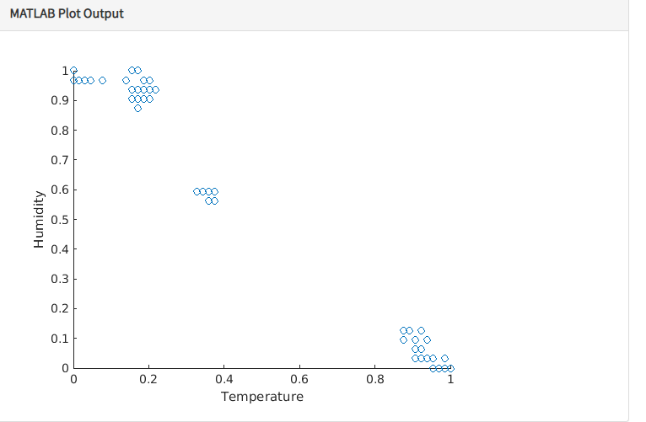
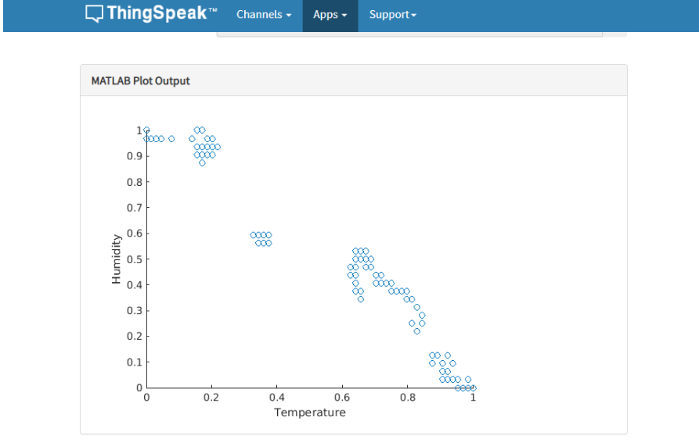
Real Time Algorithm Implementation on ThingSpeak
At 3.30 Pm
At 4.00 Pm

Slide 22
Benefits of implementation of Algorithm to Thing Speak Server:
Previously we were extracting the data from the server and then applying our code but now as we have implemented the code directly in the server there is no need for extracting.
Algorithm successfully works on the real time data and further analysis can be done.
As in the previous slide, if we observe 2nd & 3rd cluster at both the time instance, we can se the difference in the cluster formation that happens because of addition of data points.
Hence, the algorithm works properly and with time, data is getting added and reflected in the output.

Slide 23
Conclusion:
In this project, a real-time data collection of soil parameters, namely temperature, humidity and soil moisture level, has been established through a microcontroller driven circuit.
A CAD model of the actual A-IoT Cube has been created in AutoCAD Software, inside which the circuit will be mounted.
Communication establishment between circuit and the Cloud platform has been implemented with the help of an ESP8266 Wifi Module, that transfers data to the cloud platform ‘ThingSpeak’ with minimal Internet usage.

Slide 24
A Machine Learning Algorithm Model has been established which uses K-Means Clustering Algorithm to determine various soil parameter limits, and will be further more accurate when tested on a real farm.
A Mobile Application has been developed on the MIT App Inventor Platform which shows the sensor readings in a digital and graphical format in real-time with again, a minimal Internet usage.
An alerting system has been set up that sends an alert message to a defined Mobile number and sends an Email alert to a defined Email ID whenever any soil parameter crosses a safe limit, in a cost-free way, using the platform IFTTT for the same.

Slide 25
Future Scope:
The project in future, aims the model to be developed to a better extent in the ways of testing the model on a real farm ( has been a constraint in the current scenario) and training the ML model on a variety of crops to have the determined limits for a greater number of crops.
Hence, increase a parameter of setting in the model where the farmer mentions the crop he is going for and accordingly every connected system adapts.
3D printing of the designed CAD Model, to physically mount on farms.
A higher degree of digitalisation can be introduced by connecting irrigation facility to this model, which can be operated by a click on the app.

Slide 26
REFERENCES
Shi, X.; An, X.; Zhao, Q.; Liu, H.; Xia, L.; Sun, X.; Guo, Y. State-of-the-Art Internet of Things in Protected Agriculture. Sensors 2019, 19, 1833.
M. Ayaz, M. Ammad-Uddin, Z. Sharif, A. Mansour and E. M. Aggoune, "Internet-of-Things (IoT)-Based Smart Agriculture: Toward Making the Fields Talk," in IEEE Access, vol. 7, pp. 129551-129583, 2019.doi: 10.1109/ACCESS.2019.2932609
Barun Basnet, Junho Bang, "The State-of-the-Art of Knowledge-Intensive Agriculture: A Review on Applied Sensing Systems and Data Analytics", Journal of Sensors, vol. 2018, Article ID 3528296, 13 pages, 2018. https://doi.org/10.1155/2018/3528296
https://www.nrcs.usda.gov/Internet/FSE_DOCUMENTS/nrcs142p2_053280.pdf
https://realpython.com/k-means-clustering-python/
https://appinventor.mit.edu/explore/ai2/tutorials

Slide 27


